Slide 1
FACTORS INFLUENCING ACCELERATION OF A VEHICLE
SUBMITTED BY: AYUSHI SINGH

Slide 2
TABLE OF CONTENTS .
Introduction
Data Preparation and Description
Model Planning and Building
Plot of the prediction
Conclusion

Slide 3
Introduction
We aim to detect variables that will determine the acceleration of a vehicle. An instances of a variable: The consumption per mile of diesel or gasoline of the vehicle, number of horsepower inside the engine of the vehicle, brand of the vehicle and number of years that the vehicle had being used.
This data set is composed of 392 rows and 9 variables. We have used a data that gathers information about some 392 vehicles from different types of brand.
As we build a model with all these variables, we make the selection of variables based on testing hypothesis and on comparing the full and the reduced model using ANOVA method.
Discuss the effect of those selected variables on the acceleration.
We verify hypothesis related to the model we build and verify if the model is strong enough.

Slide 4
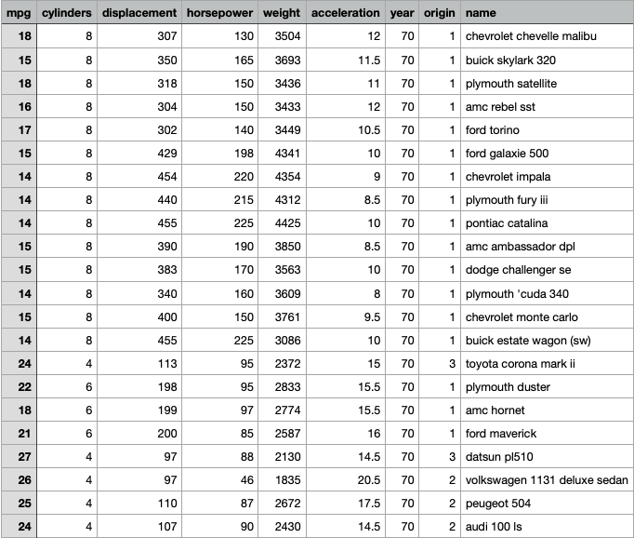
Data Preparation

Slide 5
.
The data set is composed of 392 rows and 9 variables, those variable are :
## [1] "mpg" "cylinders" "displacement" "horsepower" ## [5] "weight" "acceleration" "year" "origin" ## [9] "name”
mpg : is Miles per gallon cylinders : Number of cylinders inside the vehicles displacement : Engine displacement horsepower : Engine horsepower weight : Weight of the vehicle acceleration : Time to accelerate from 0 to 60 mile per hour year : Model year origin : Vehicle origin name : The name of the vehicle

Slide 6
Data Description
By doing those transformations, we give a statistical description about our variables.
We can notice that there is no missing value in all continuous variables, we make a table stating summary about statistics like the mean and median, the max and the mean, the variation and coefficient of variation for each continuous variables. Regarding the categorical variable, we present the frequency of each modality.
We notice that 62.5% of vehicles are from USA, 17.3% are from UE and the rest of vehicles are from Japan.

Slide 7
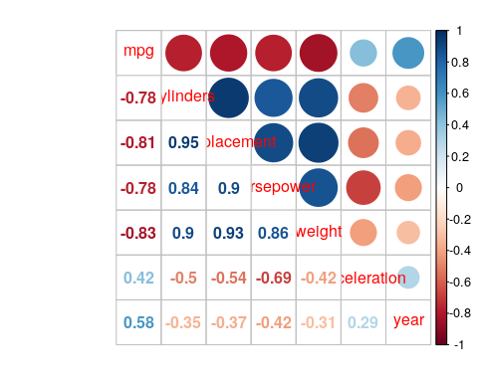
Correlation between variables:
. We notice that there is a negative correlation between acceleration and horsepower, displacement, cylinders that exceed 0.5 ,the correlation between acceleration and other variables does not exceed 0.5

Slide 8
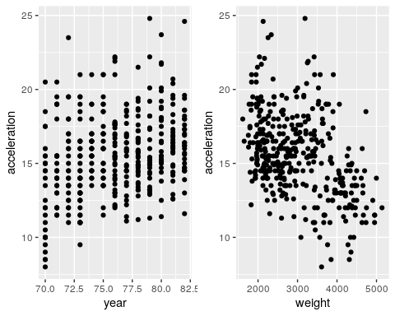
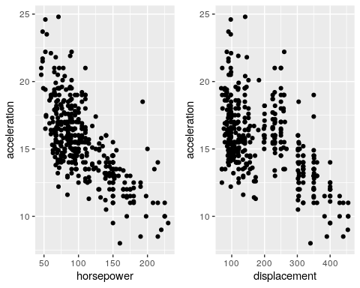
Graphics of the dependent variable VS independent variables:
Plot 1: Plot 2:
Acceleration does not vary much, By increasing displacement,
but considering weight, the more vehicle or horsepower acceleration
is heavy the more acceleration is low. become low.

Slide 9
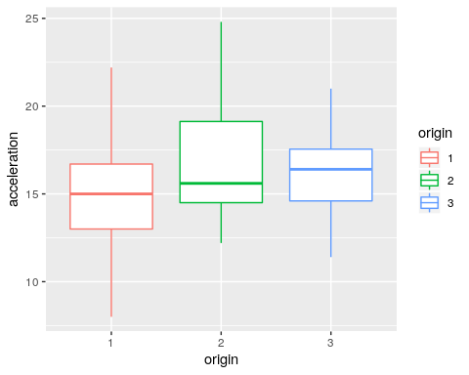
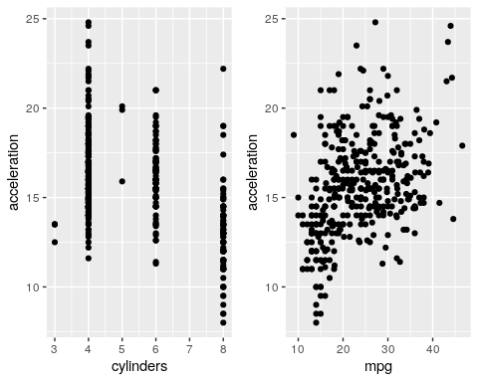
.
Plot 3: Plot 4:
Vehicle with 4 cylinders have Vehicle from US have a
high acceleration than vehicles mean acceleration low than
with 8 cylinders as well as vehicle from UE or Japan.
vehicles with more mpg
have high acceleration.

Slide 10
Model Planning and Building
From the output of our regression, we notice that significant variables are : displacement, horsepower, weight and year.
- displacement is significant at a 5%, since it’s p-value is less than 0.05 , an increase (decrease) of deplacement of on unit will decrease (increase) acceleration by 0.0081
- horsepower is significant at a 5% since it’s p-value is less than 0.05 , an increase (decrease) of horsepower of on unit will decrease (increase) acceleration by 0.085 .
- weight is significant at a 5% since it’s p-value is less than 0.05 , an increase (decrease) of weight of on unit will increase (decrease) acceleration by 0.003 .
- year is significant at a 10% since it’s p-value is less than 0.1, an increase (decrease) of year of on unit will decrease (increase) acceleration by 0.096

Slide 11
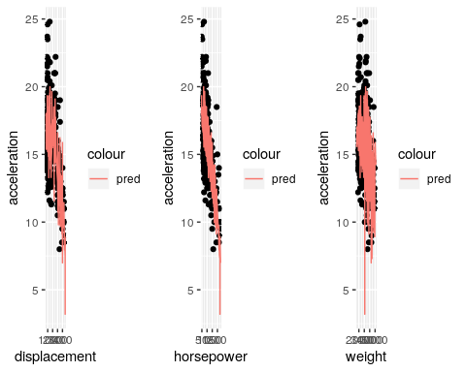
Plot of the Prediction

Slide 12
Conclusion
Among all the characteristics related to vehicles, only three characteristics were retained to explain acceleration: displacement, horsepower and weight
They were retained using two different methods:
1. using the reg-subsets which give us the best model within a criteria
2. using hypothesis and testing whether coefficient of other variable could be equal to zero or not
For the first hypothesis Normality of residuals: the solution is to increase number of variables
For the second hypothesis Homoscedastivity : we can propose three solutions- scaling our data and then fitting the model; use the logarithm of acceleration and combine the two previous solutions
For the third hypothesis Multicolinearity: the solution is to delete displacement from the model since there is strong correlation between this variable and horsepower

